Slide 2
Agenda
Intro to Containers
Benefits of using Containers
Remote Development Extension
Devcontainers
Demo
Notes:
Cost: There needs to be physical machine per each application with a huge-cost factor.
Slow Deployment: The process of purchasing and on boarding physical servers are painful and result in slow deployment.
Hard to Migrate: There is a significant amount of configuration changes and lot of manual intervention to migrate to a different physical machine.

Slide 3
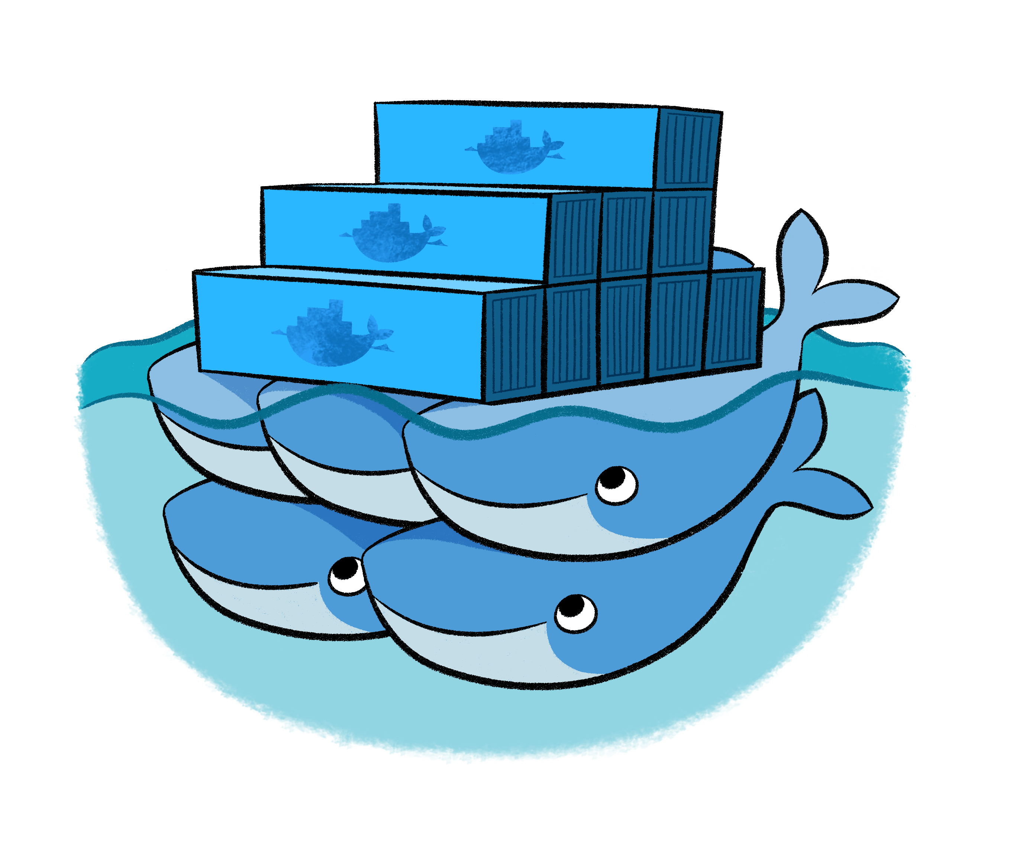
Intro To Containers
Notes:
Rkt
Podman
containerd

Slide 4
Before Virtualisation
Application
bin / libs
Host Operating System
Physical Server
Notes:
Cost: There needs to be physical machine per each application with a huge-cost factor.
Slow Deployment: The process of purchasing and on boarding physical servers are painful and result in slow deployment.
Hard to Migrate: There is a significant amount of configuration changes and lot of manual intervention to migrate to a different physical machine.

Slide 5
Hypervisor Virtualisation
Application
Application
Application
bin / libs
bin / libs
bin / libs
Guest OS
Guest OS
Guest OS
Hypervisor
Host Operating System
Physical Server
Notes:
Cost-Efficient: Each physical machine is divided into multiple VM’s which is cost effective.
East to scale: With VM’s deployed in cloud environment, It is easy to scale based on the requirement and it is not required to order and configure physical machines. More VM’s can be added/configured just with a “push button”.

Slide 6
Container Based Virtualisation
Application
Application
Application
bin / libs
bin / libs
bin / libs
Container Engine
Host Operating System
Physical Server
Notes:
Runtime Isolation: Isolate different runtime environments based on the application requirement. Let’s say application-a requires a JRE8 and application-b requires JRE7, Both the applications can be deployed in a different container in a single virtual machine which provides a application level runtime isolation.
Cost-Efficient: Container based virtualization does not create a entire virtual Operating system and Containers consume less CPU/RAM or storage space than VM’s.
Faster Deployment: Containers are very fast to boot/configure.
Guaranteed Portability: Containers are portable.

Slide 7
Containers
Onboarding
Hours to days before people are productive.
Get productive immediately
Environments
Consistency between local and remote environments.
Works on my machine no longer an excuse
Security
Build one container for everyone to use.
No reliance on each person to update their local environment
Notes:
Installing SDKs is much easier
Having multiple SDKs or versions of tools installed

Slide 8
Docker
Virtualisation
Linux
Windows / MacOS
Images
Code
Registries
Where images are stored
VM Virtualisation
Process Virtualisation
Runtimes
Libraries
Docker Hub
Azure container Registry
Notes:
Docker
Linux is process virtualisation
Windows/Mac - VM Based
Images
Code
Runtimes
Libraries
Environment vars
Registries
Where images live
Docker hub
ACR
DockerFile:
Definition of an image

Slide 9
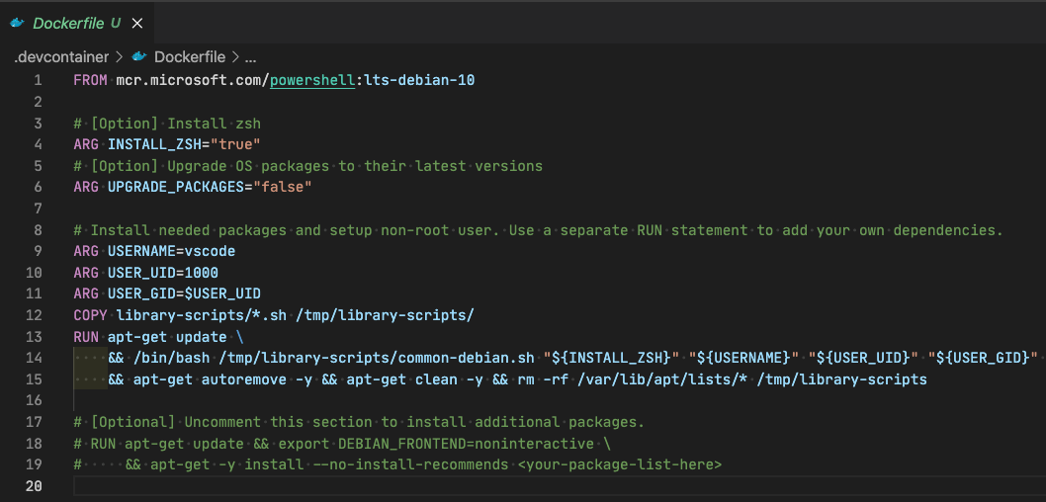
Dockerfile
Notes:
Dockerfile
| Image |
Build => Push => Registry

Slide 10
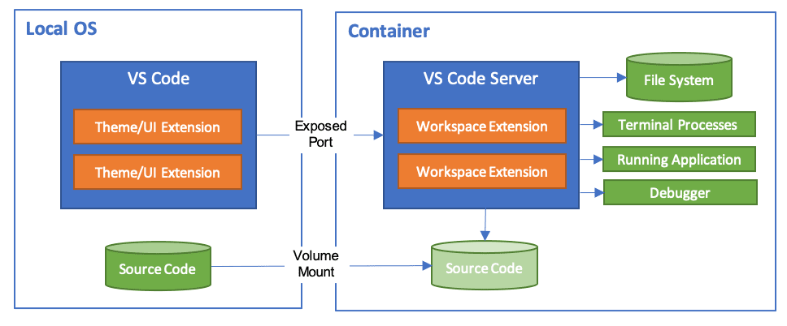
VS Code Remote Development
Notes:
Develop on the same operating system you deploy to or use larger or more specialized hardware.
Separate your development environment to avoid impacting your local machine configuration.
Make it easy for new contributors to get started and keep everyone on a consistent environment.
Use tools or runtimes not available on your local OS or manage multiple versions of them.
Develop your Linux-deployed applications using the Windows Subsystem for Linux.
Access an existing development environment from multiple machines or locations.
Debug an application running somewhere else such as a customer site or in the cloud

Slide 11
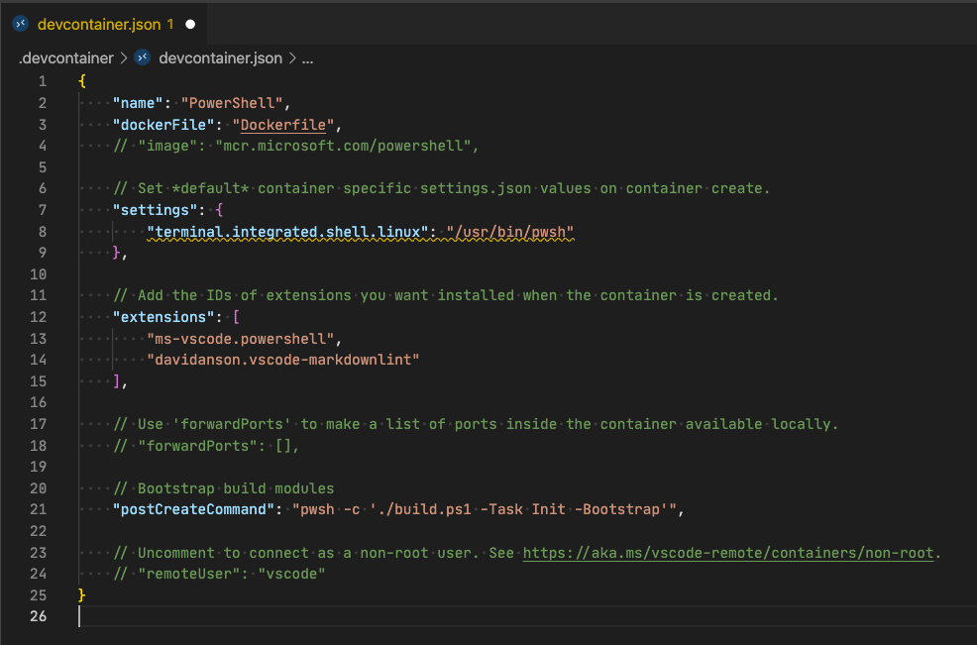
devcontainer
Notes:
Spin up a stand-alone container to isolate your toolchain or speed up setup.
Work with a container deployed application defined by an image, Dockerfile, or Docker Compose.
Use Docker or Kubernetes from inside a dev container to build and deploy your app.
If devcontainer.json's supported workflows do not meet your needs, you can also attach to an already running container instead.

Slide 12

Demo

Slide 13
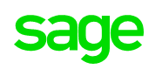



Me
 | Cloud Operations @ Sage
 | @BrettMiller_IT
 | https://github.com/brettmillerb
 | https://millerb.co.uk
Notes:
Cost: There needs to be physical machine per each application with a huge-cost factor.
Slow Deployment: The process of purchasing and on boarding physical servers are painful and result in slow deployment.
Hard to Migrate: There is a significant amount of configuration changes and lot of manual intervention to migrate to a different physical machine.

